Slide 1

Implement and Manage Azure Governance Solutions
Azure Role-Based Access Control (RBAC), Azure Policy, and Azure Blueprints

Slide 2
Learning Objectives
You will learn the following:
Create Management Groups, Subscriptions, and Resource Groups
Overview of Role-Based Access Control (RBAC)
Role-based Access Control (RBAC) Roles
Azure Blueprints

Slide 3
Create Management Groups, Subscriptions, and Resource Groups

Slide 4
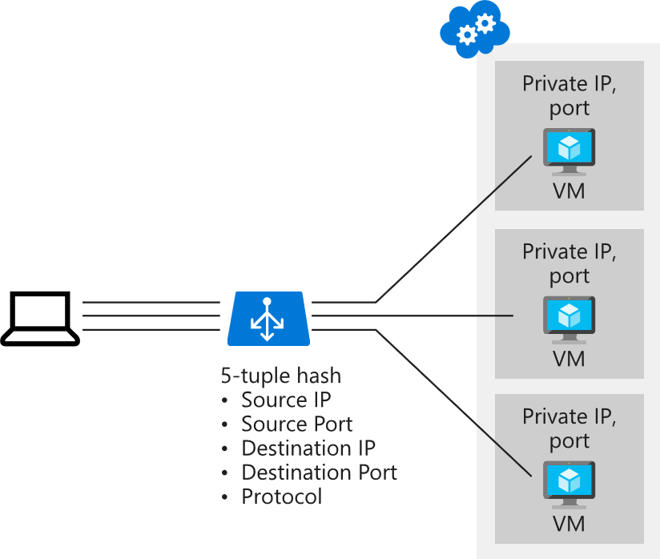
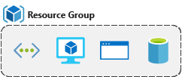
Resource Groups
A resource groups is a fundamental concept of the Azure platform
Serves as a logical grouping of resources
Ties to resource life cycle
Can't be nested
Each resource must belong to a resource group
Most resources can be moved between resource groups

Slide 5
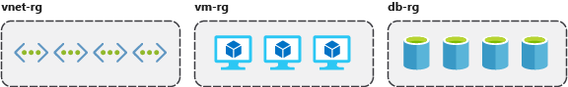
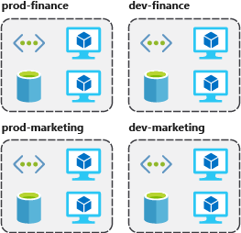
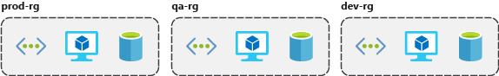
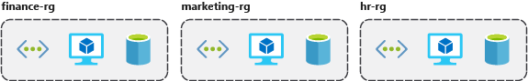
Resource Group Organization (1 of 2)
Organizing principles:
Organizing for authorization
Organizing for life cycle or usage (shared resources)
Organizing for billing

Slide 6
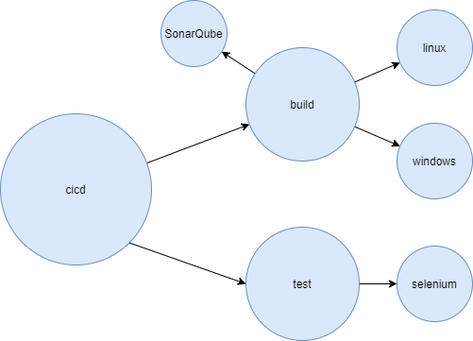
Resource Group Organization (2 of 2)
Consistent naming convention
domain-resource-location-environment
cicd-build-linux-rg01-weu-prd
cicd-build-linux-vm01-weu-prd
cicd-build-linux-nic01-weu-prd
Recommended naming and tagging conventions
Tags

Slide 7
Discussion: Design Naming convention
Draw domain diagram, you can use draw.io
Design naming convention that would work best for your organization

Slide 8
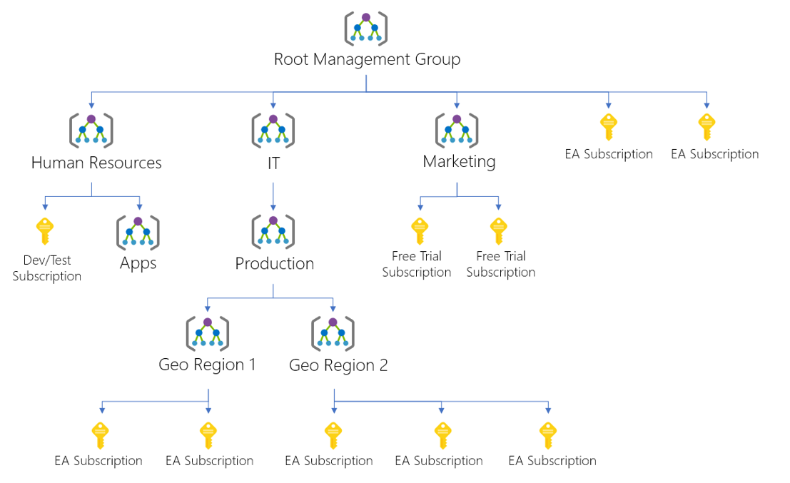
Management Groups
Provides a level of scope above subscriptions
Targeting of policies and spend budgets across subscriptions and inheritance down the hierarchies
Compliance and cost reporting by organization (business/teams)

Slide 9

Subscriptions and Limits (Quotas)
Azure subscription and service limits:
Microsoft Azure limits are also called quotas
Some limits apply on the regional level
Managing limits:
You can raise soft limits by raising an online customer support request at no charge

Slide 10
Subscription and Service General Limits
Management group limits
Subscription limits
Resource group limits
Template limits

Slide 11

Overview of Role-Based Access Control (RBAC)

Slide 12
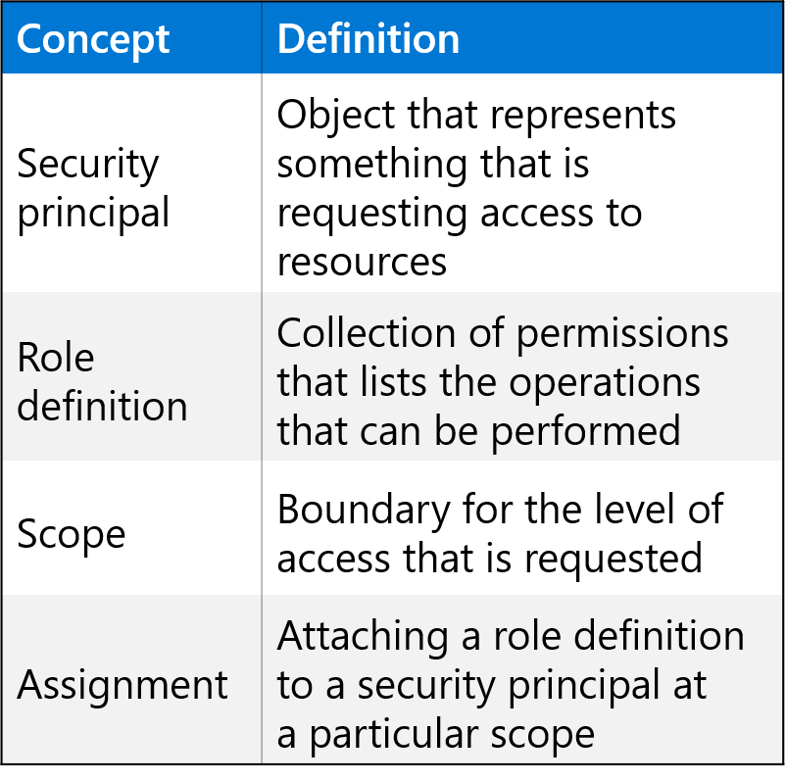
Role-Based Access Control (RBAC)
Provides fine-grained access management of resources in Azure​.
Built on Azure Resource Manager.
Segregate duties within your team.
Grant only the amount of access to users that they need to perform their jobs​.
Users can grant access described in a role definition by creating an assignment​.
Deny assignments are currently read-only and are set by Azure Blueprints and Azure Managed Apps.

Slide 13
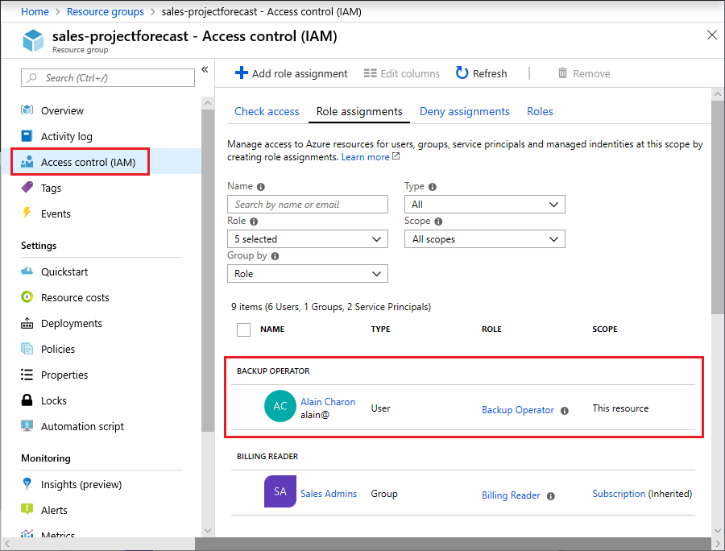
RBAC in the Azure Portal
An IAM pane for a resource group:

Slide 14
How RBAC Works (1 of 4)
You control access to resources using RBAC by creating role assignments
To create a role assignment, you need three elements
a security principal
a role definition
a scope
You can think of these elements as "who", "what", and "where".

Slide 15
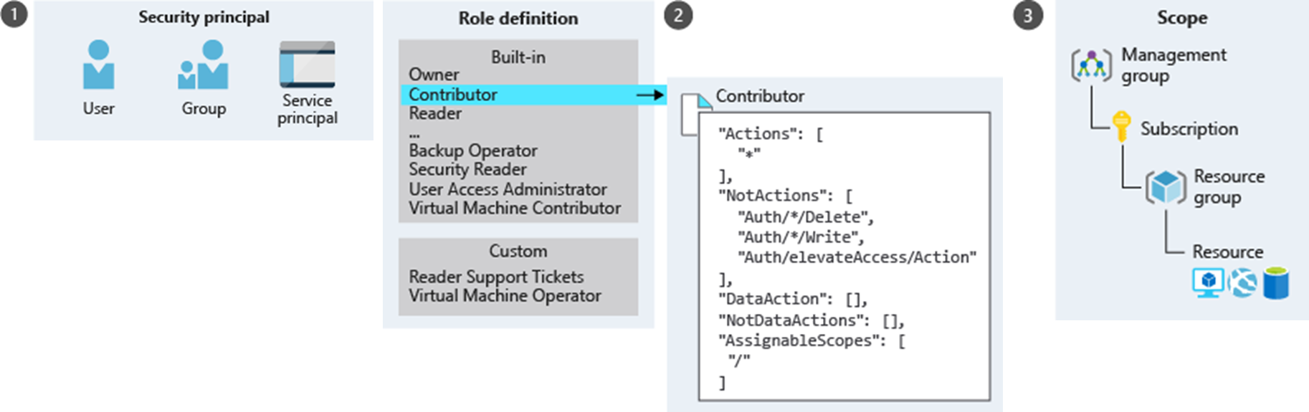
How RBAC Works (2 of 4)
Security principal
Role definition
Scope

Slide 16
How RBAC Works (3 of 4)
Collection of permissions that lists the operations that can be performed
Owner
Contributor
Reader
…
Backup Operator
Security Reader
User Access Administrator
Virtual Machine Contributor
"Actions": [
"*"
],
"NotActions" : [
"Authorization/*/Delete",
"Authorization/*/Write",
"Authorization/elevateAccess/Action"
],
"DataActions" : [],
"NotDataActions": [],
"AssignableScopes" : [
"/"
]
Built-in
Reader Support Tickets
Virtual Machine Operator
Custom
Contributor
Notes:
Describe the format and syntax of an Azure RBAC role definition.

Slide 17
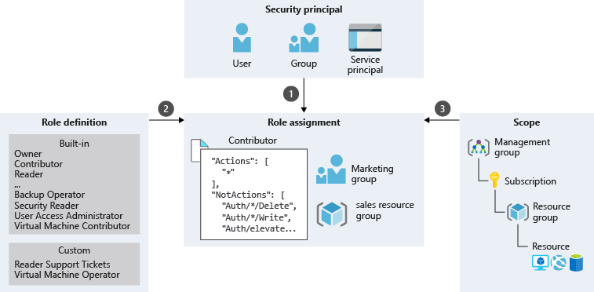
How RBAC Works (4 of 4)
RBAC is an allow model:
Permissions are cumulative
There no explicit deny

Slide 18
Role-Based Access Control (RBAC)

Slide 19
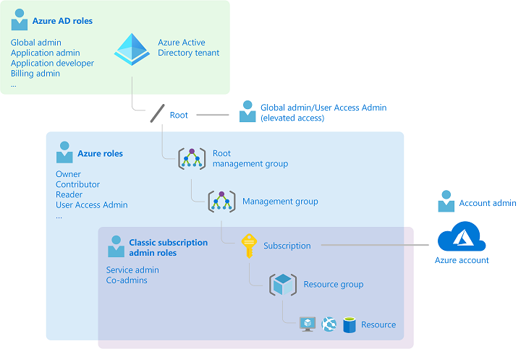
Administrator Roles, Azure Roles, and Azure AD Roles (1 of 4)
There are three general groups of roles in the context of Azure and Azure AD
Classic subscription administrator roles
Azure roles
Azure AD roles
How the roles are related

Slide 20
Administrator Roles, Azure Roles, and Azure AD Roles (3 of 4)
Azure RBAC roles
Azure role | Permissions | Notes
Owner | Full access to all resourcesDelegate access to others | The Service Administrator and Co-Administrators are assigned the Owner role at the subscription scope Applies to all resource types.
Contributor | Create and manage all of types of Azure resources Create a new tenant in Azure Active Directory Cannot grant access to others | Applies to all resource types.
Reader | View Azure resources | Applies to all resource types.
User Access Administrator | Manage user access to Azure resources

Slide 21
Administrator Roles, Azure Roles, and Azure AD Roles (4 of 4)
Azure AD role | Permissions | Notes
Global Administrator | Manage access to all administrative features in Azure Active Directory, as well as services that federate to Azure Active DirectoryAssign administrator roles to othersReset the password for any user and all other administrators | The person who signs up for the Azure Active Directory tenant becomes a Global Administrator.
User Administrator | Create and manage all aspects of users and groupsManage support ticketsMonitor service healthChange passwords for users, Helpdesk administrators, and other User Administrators
Billing Administrator | Make purchasesManage subscriptionsManage support ticketsMonitors service health

Slide 22









RBAC Authentication
Azure AD
Admin roles
Azure Active
Directory tenant
Global admin
Application admin
Application developer
Billing admin
…
Global admin/User access admin (elevated access)
Root
Azure RBAC
roles
Root management group
Owner
Contributor
Reader
User access admin
…
Management group
Subscription
Azure RBAC
roles
Resource group
Azure account
Owner
Contributor
Reader
User access admin
…
Resource

Slide 23
Demonstration: Add an Azure Role Assignment
What roles depending on environment should be assigned to DevOps / Dev / AppSupport

Slide 24
Implement and Configure an Azure Policy

Slide 25
Azure Policy Overview (1 of 2)
How are Azure Policy and RBAC different
Applying a policy
Create a policy definition
Assign a definition to a scope of resources
View policy evaluation results
What is a policy definition?
Allowed storage account SKUs
Allowed resource type
Allowed locations
Allowed virtual machine SKUs
Not allowed resource types

Slide 26
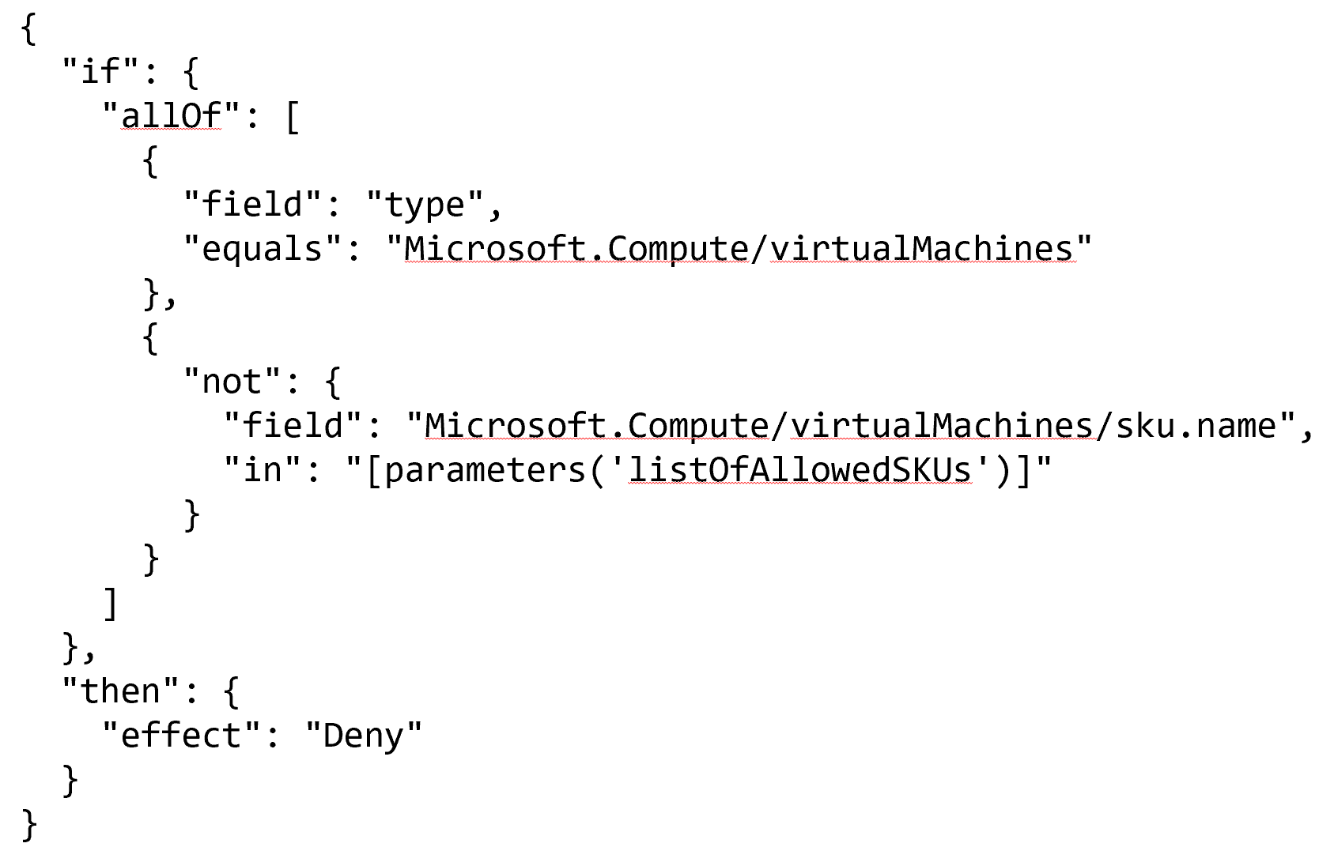
Azure Policy Overview (2 of 2)

Slide 27
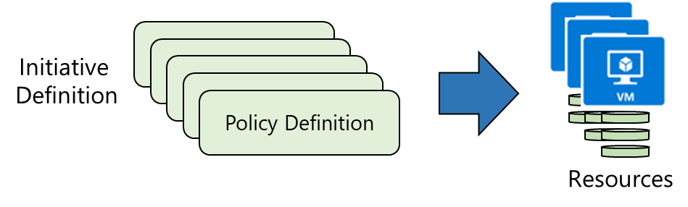
Implementing Azure Policy
Browse policy definitions
Create initiative definitions
Scope the initiative definition
View Policy evaluation results
Notes:
The next topics step you through creating an Azure policy.
Note: Even if you have only a few policy definitions, we recommend creating an initiative definition.

Slide 28
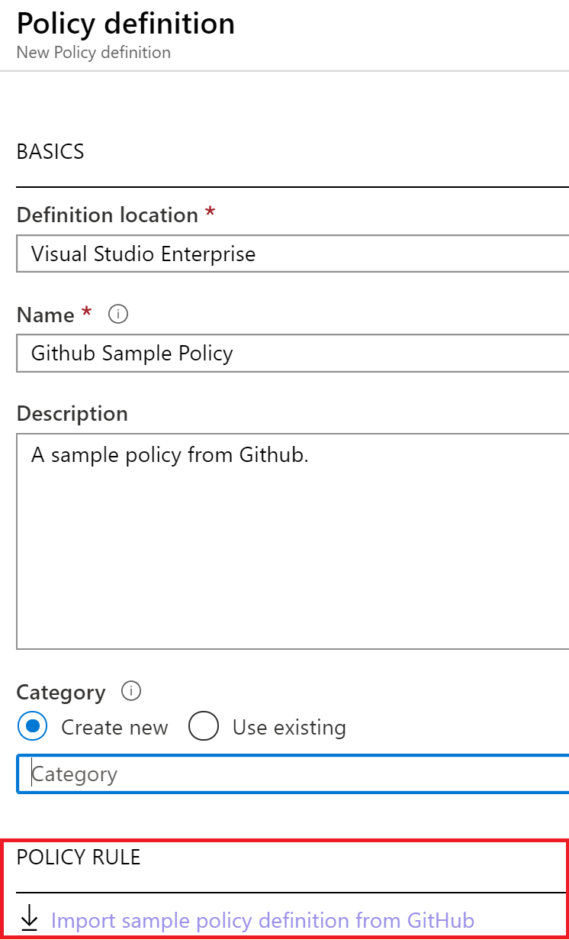
Policy Definitions
Many policy definitions are available.
You can import policies from GitHub.
Policy definitions have a specific JSON format.
You can create custom policy definitions.

Slide 29
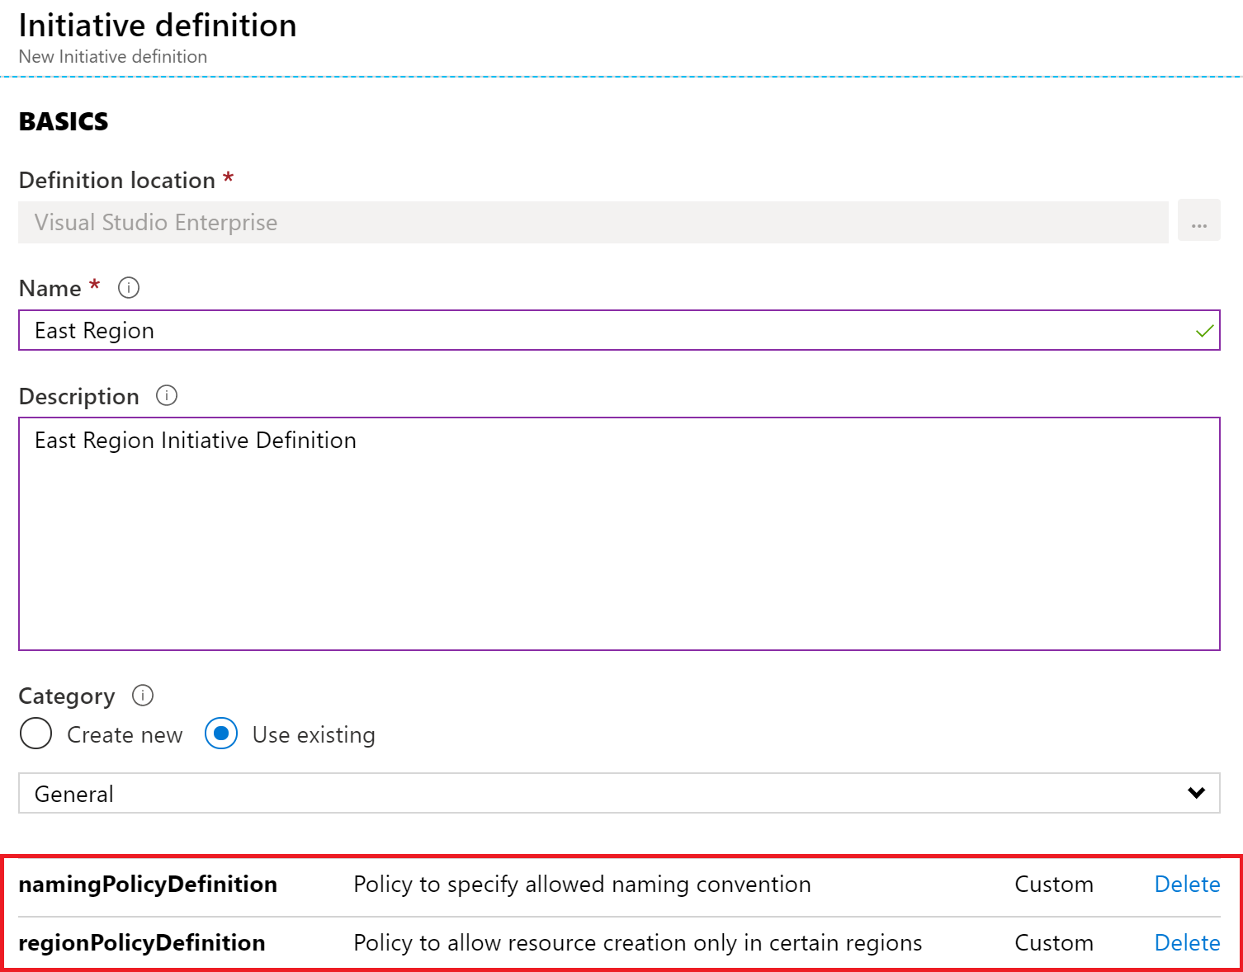
Create Initiative Definitions
Group policy definitions
Include one or more policies
Requires planning
Notes:
Suggested discussion topic: Can you see how this will require some planning to organize your policies?

Slide 30
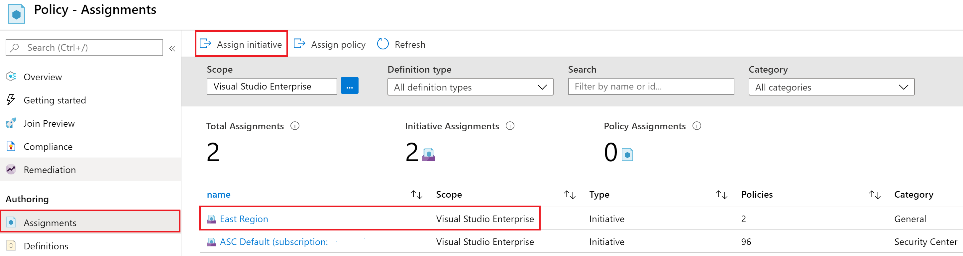
Scope the Initiative Definition
Assign the definition to a scope
The scope enforces the policy
Select the subscription, and optionally the resource group
Notes:
Note: Currently, an Initiative Definition can have up to 100 policies.

Slide 31
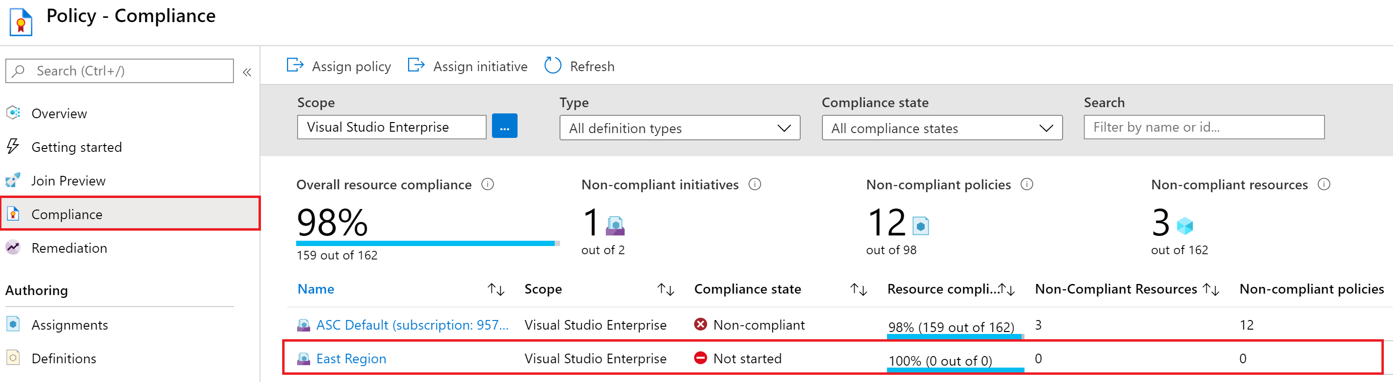
Determine Compliance
Non-compliant initiatives
Non-compliant policies
Non-compliant resources
Notes:
Policy evaluation happens about once an hour, which means that if you make changes to your policy definition and create a policy assignment then it will be re-evaluated over your resources within the hour.

Slide 32
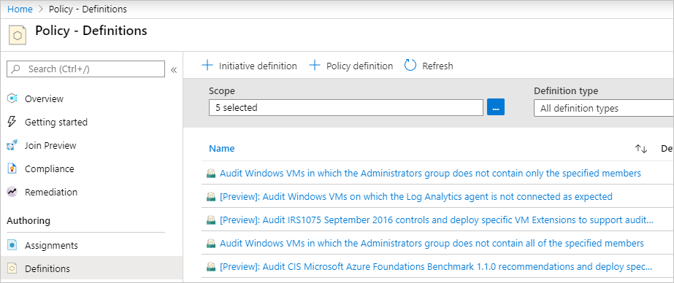
Implement a New Custom Policy
Scenario: create a new custom policy to save costs by validating that VMs created in your environment can't be in the G series.
Every time a user in your organization tries to create VM in the G series, the request is denied.

Slide 33
Demonstration: Create and Manage Policies to Enforce Compliance
Assign a policy

Slide 34
Azure Blueprints

Slide 35
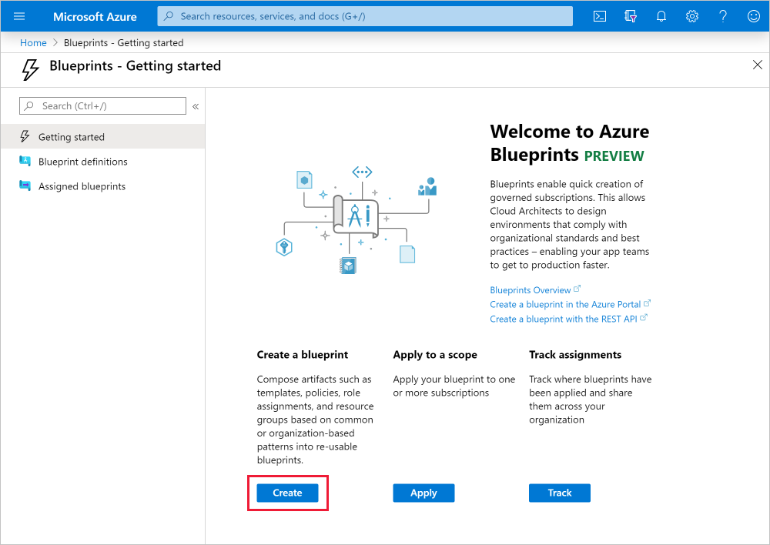
Azure Blueprints
Azure Blueprints is a declarative way to orchestrate the deployment of such artifacts as policy
Role assignments
Policy assignments
ARM templates
Resource groups
How is this different from ARM templates
How is this different from Azure policy

Slide 36
Azure Policy vs. Azure Blueprints
Azure Policy
Azure Blueprints
Helps to enforce organizational standards and to assess compliance at-scale
Provides an aggregated view to evaluate the overall state of the environment
Helps to bring your resources to compliance through bulk remediation for existing resources and automatic remediation for new resources
Enables cloud architects and central information technology groups to define a repeatable set of Azure resources that implements and adheres to an organization's standards, patterns, and requirements
Makes it possible for development teams to rapidly build and stand up new environments with trust they're building within organizational compliance

Slide 37
Demonstration: Create a Blueprint
Create a blueprint

Slide 38
Thanks!

